Slide 1
Worker register and inclusion criteria
Management of Benzene & Mercury exposure offshore
Hans Thore Smedbold

Slide 2
Content
Risk assessment
Exposure assessment
Worker register
Management of benzene and mercury exposure

Slide 3
Risk assessment

Slide 4
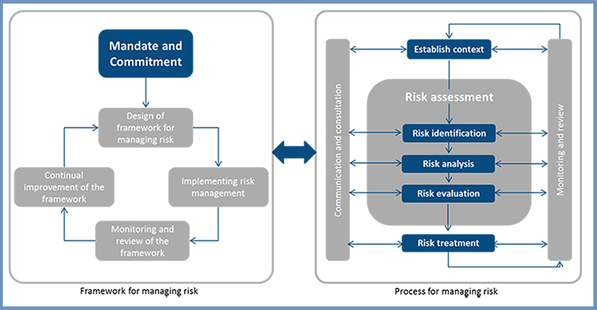
The risk asssessment framework and process
(ISO 31000)

Slide 5
Establish context
Backward Forward
Retrospective
Prospective
Different contexts /
perspectives:
Medical (dose (exposure) – respons)
Regulatory Compliance
Worker protection (NOROG)

Slide 6
Regulatory Compliance
Qualitative Requirements
Occupational Exposure limits
Assessment strategy
Assessment criteria

Slide 7
OELs Benzene (in ppm)
Country | 8-hour | STEL | 12-hour | Short term
N | 1.0 |  | 0.6 | 3
NL | 1.1 / 0.2
UK | 1.0
ACGIH | 0.5 | 2.5
NIOSH | 0.1 | 1
Neptune Energy | 0.2 | 2.5 | 0.12 | 2.5

Slide 8
Context – requirements to our strategy
Compliance assessment (no day with exposure above the OEL) (EU chemical directive)
The average / long term exposure (worker register)

Slide 9
Worker register and inclusion criteria

Slide 10
Content
Background
How this is are implemented in Norway
Inclusion criteria
Is or can be exposed
Example of implementation

Slide 11
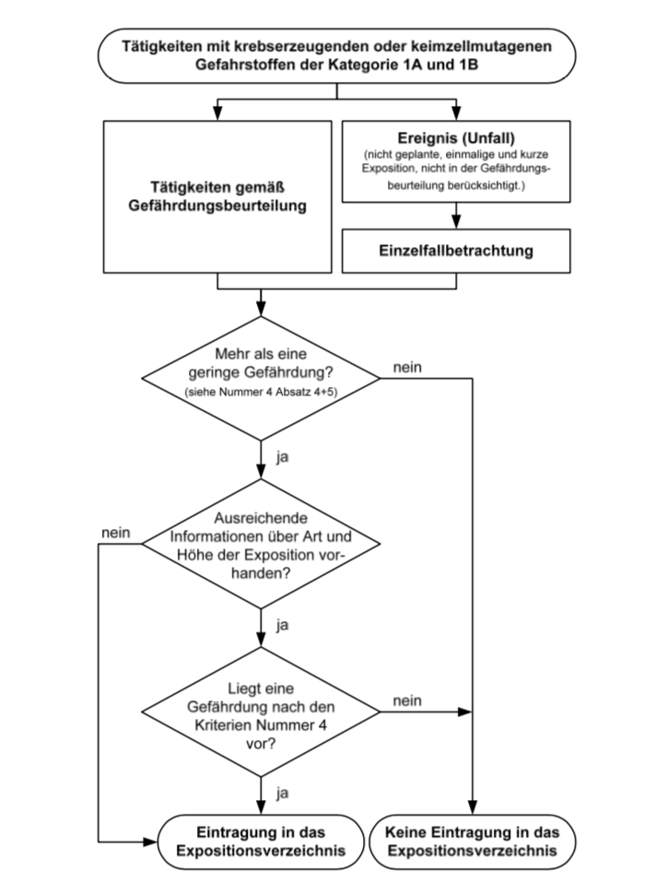
It started with ILO
First required by ILO in 1974
First mentioned in Norway in 1978
In different EU directives
Different implementation in national regulations
Agents:
  Carcinogenic (1A and 1B),
  Mutagenic and lead substances
  Radiation
  Asbestos, and
  Biological agents (group 4 and 5)

Slide 12
Examples of national implementations
Austria: Register of all worker handling agents subject to registration regardless of exposure.
Norway: Register all workers that are or can be exposed. Registered information shall contain information regarding exposure level.

Slide 13
Norwegian Labour Inspectorate (NLI)
The employer shall establish a register of workers that are or can be exposed to agents subject to this regulation.
The regulation specifies which agents that is subject for the register.
Which information that shall be registered.
Who should have access to the register (VO, worker, HSE / OHS personnel, managers).
The retention / storage time of the register (> 60 years).
Inclusion in the register shall not take into account the effect of PPE
The register shall include information about the exposure level.
For later use of the information I will also recommend registration regarding use of PPE (as part of the exposure level description).

Slide 14
Aim of the register (as stated by NLI)
For the company:
  Part of the systematic HSE work to control and improve the working condition
  Basis for risk based medical follow up of the worker
For the worker:
  Documentation of individual exposure
For the society:
  Research

Slide 15
What is mend by being “exposed to”
Working with
Being in the vicinity of (access control + chemical index / storage chart)
Risk assessment (WEHRA)
Need to use respiratory protection (hours with respirators)
A fraction of the OEL (document exposure level)

Slide 16

Is or can be exposed
«Is exposed»
Yearly update
Kari Normann:
Prosessoperatør Exposed
Kontrollromsoperatør Unexposed
Prosessingeniør land Unexposed
«Can be exposed»
«Un-exposed»

Slide 17
Is or can be exposed
XXXXX (Norway):
One or more days a year with full shift exposure > 1/10 of the OEL

Slide 18

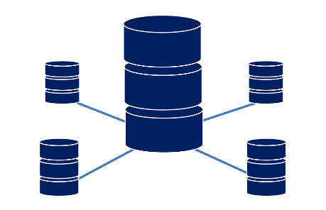

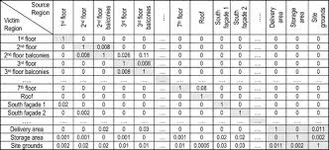
Two ways into the register (JEM and OHS)
Activity and process data (WO)
Exposure measurements (point samples and OH measurements)
Work Related Illnesses
Area charts (WEAC)
Risk assessments mm
HR - data
Jobb exposure matrix (JEM)
Worker register
Feedbakck to worker being included into the register
OHS

Slide 19
Risk assessment, cont.

Slide 20
Annual population of exposures for one worker: 250 Worker-days per Year

Slide 21
Hypothetical exposures for a Category 4 worker per year (OEL=1):

Slide 22
What is an appropriate distributional model for describing the exposure profile?
  Lognormal ?
  Normal ?
  Something else ?

Slide 23
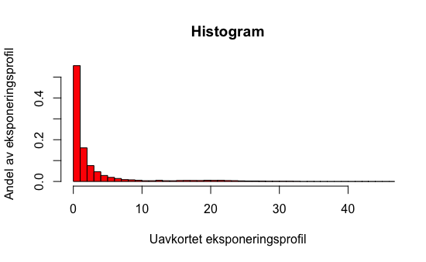
Example of a possible «thrue» exposure profile
Unexposed days (30%),
Days with only tasks with short – high exposure (65%)
Days with long – high exposure (5 %)
Null eksponering + lav eksponering
Sjelden høy fullskifts eksponering – knyttet til vedlikehold etc.

Slide 24
Exposure profile
0,014
95%il
UTL
0,012
OEL
95%il = 95 prosentil
UTL = Upper Tolerance Limit
OEL = Occupational Exposure Limit
0,01
0,008
0,006
0,004
0,002
0
0
50
100
150
200
250
300
Consentration

Slide 25
Normal distribution
Area = 0.684
Area = 0.954
μ−σ
μ
μ+σ
μ−2σ
μ+2σ
When the data fit the normal distribution, its known properties can be used
Notes:
This is a picture of a normal distribution.
If you look at data within one standard deviation from the mean, note that the curve would cover 68.4% of the data.
If you look at data within two standard deviations from the mean, note that the curve would cover 95.4% of the data, leaving approx. 2.5% in each tail.
This information will be helpful when we are concerned about what percent of the data are less than a certain value, e.g. are in compliance.

Slide 26
Special issues
Truncated data (what we didn't measure)
Censored data (values above or below the measurement range of your instrument)
Is there any true «null» exposed ?

Slide 27
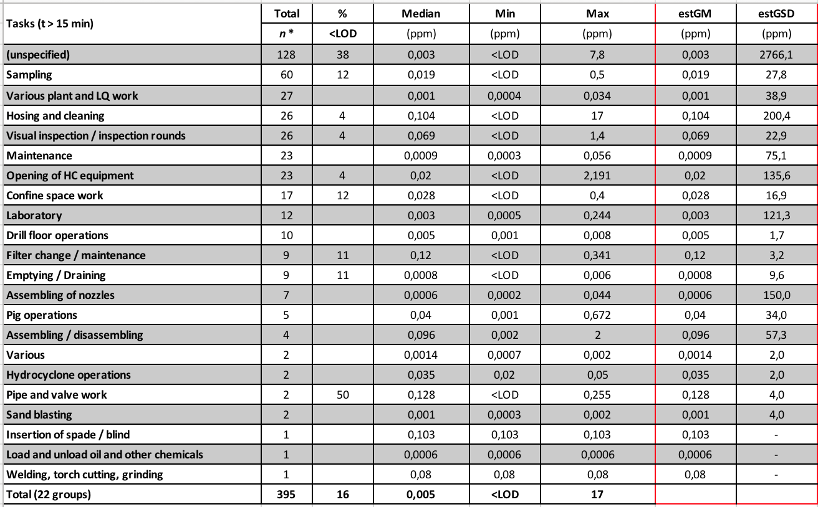
2007-09 STAMI report 9/2011

Slide 28
New assessment criteria (EN-689 (2018))
Minimum 3 “full shift” measurements
For small measurement series (3-5 measurements):
  N = 3 Maximum value less than 10% of limit value
  N = 4 Maximum value less than 15% of limit value
  N = 5 Maximum value less than 20% of limit value
For "medium sized" datasets (6-10 measurements):
  Check exposure profile (professional judgement). Assume log-normal if it cannot be proved otherwise. For values ​​of GSD (geometric standard deviation) > 3.5-4, evaluate whether the measurements can be grouped differently (see standard for identifying comparable exposed groups (SEG).
  x = measurement values
  Calculate: y = ln (x) for all measurements
  Calculate: average of y (y_bar) and standard deviation to y (s_{y})
  Calculate: GSD = exp (s_{y})
  Calculate X_{(0.95.0.70)} = exp (y_bar + U_{T} * s_{y}), where U_{T} (see table)
  Compare X _{(0.95,0.70)} with OEL. If X_{(0.95.0.70)} less OEL, the exposure may be considered to be below the limit, if equal or above the OEL the exposure is not considered to be in compliance with the regulations.
No samples | U_{T}
6 | 2,18677
7 | 2,12007
8 | 2,072
9 | 2,035
10 | 2,005

Slide 29
«New» assessment strategy
Must be aible to document exposure and absent of exposure «null» exposure. Use of activity log (log book).
Identify tasks with exposure (log book + VOC (PID)).
Fullshift measurement with dose badges (3M 3500 or ATD tubes).
Detailed exposure assessment related to identified exposed tasks (from A and B)) by Occupational Hygienist (source strength measurements + breathing zone measurements).

Slide 30
Mapping of process streams
Closed system sampling
Head space analyses

Slide 31
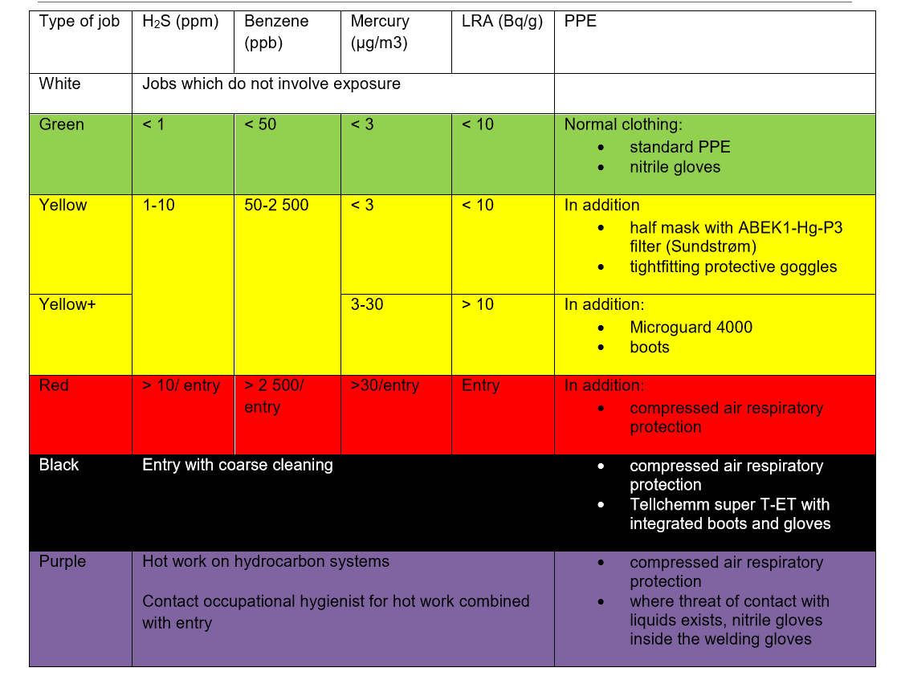
Worker protection regime (NOROG guideline 131)
Benzen applied as an indicator of health risk related to HC exposure
«Trigger value» for use of respirator protection - 0,05 ppm
(0,05 ppm level of detection (LOD) Dräger CMS)

Slide 32
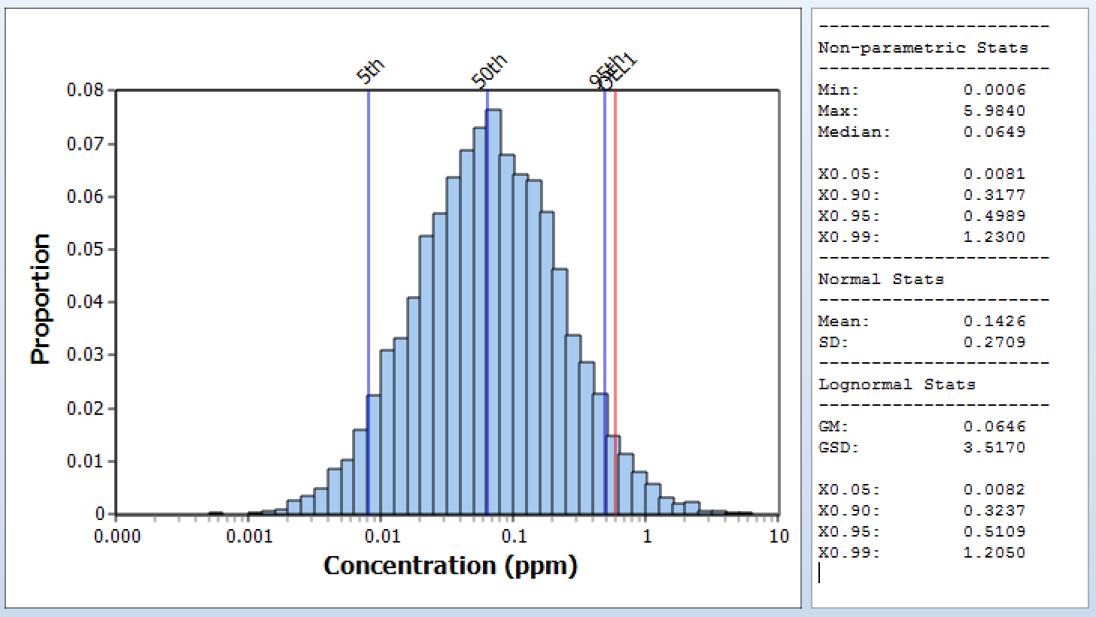
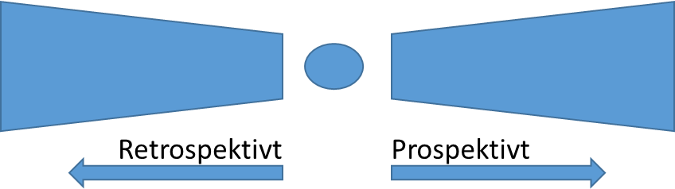
Comparison of the different perspectives
 | Medical * | Regulatory compliance * | Worker Protection NOROG
Criteria | 0.5 ppm (long term exposure) | 0.5 ppm (8-hour)* | 0.05 ppm (point sampling, often close to source)
Desition statistics | Aritmetisc mean, cumulative exposure | Geometric mean, 95-persentil, X_{(0.95.0.70)} | Direct comparison with trigger value
What characterizes a deviation | Regular fullshift exposure with HC | Sporadically fullshift exposure > OEL | Sporadically task exposure > trigger value
Cumulative lifte time exposure (40 year with «acceptable» exposure) | 20 ppm*year | < 4.8-14 ppm*year | < 0.2 ppm*year
* ACGIH TLV for benzene

Slide 33
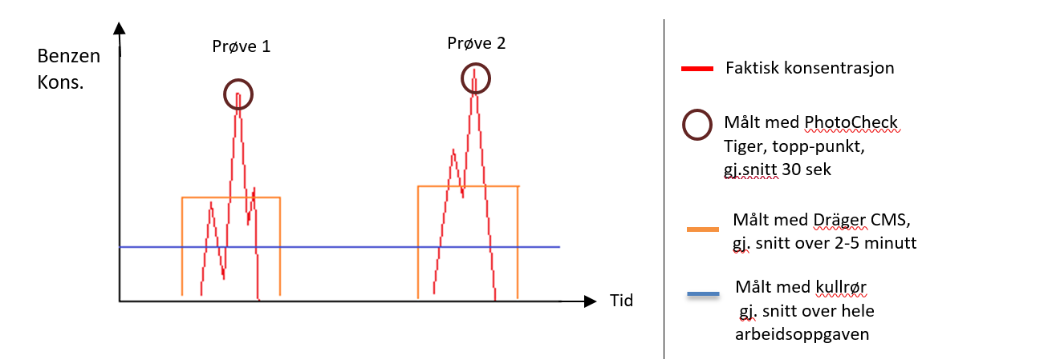
Barrier requirements
Depends on selected perspektive og assessment method
A retrospective assessment compared to 20 ppm*year, or
Woker protection (NOROG 131) 0.05 ppm (spot sampling)

Slide 34
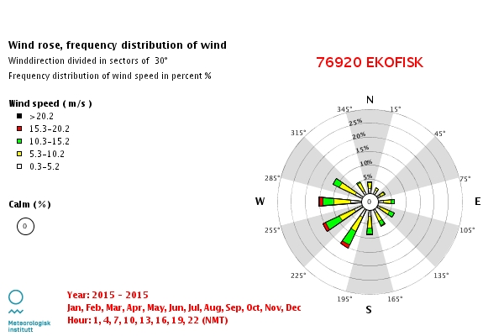
Exposure influencing factors.
EXAMPLE WIND
Wind speed (m/s) | Influence
< 2 | Lav
2-5 | Moderat
5-10 | Høy
>10 | Høy
80 % OF THE TIME > 5 m/s

Slide 35
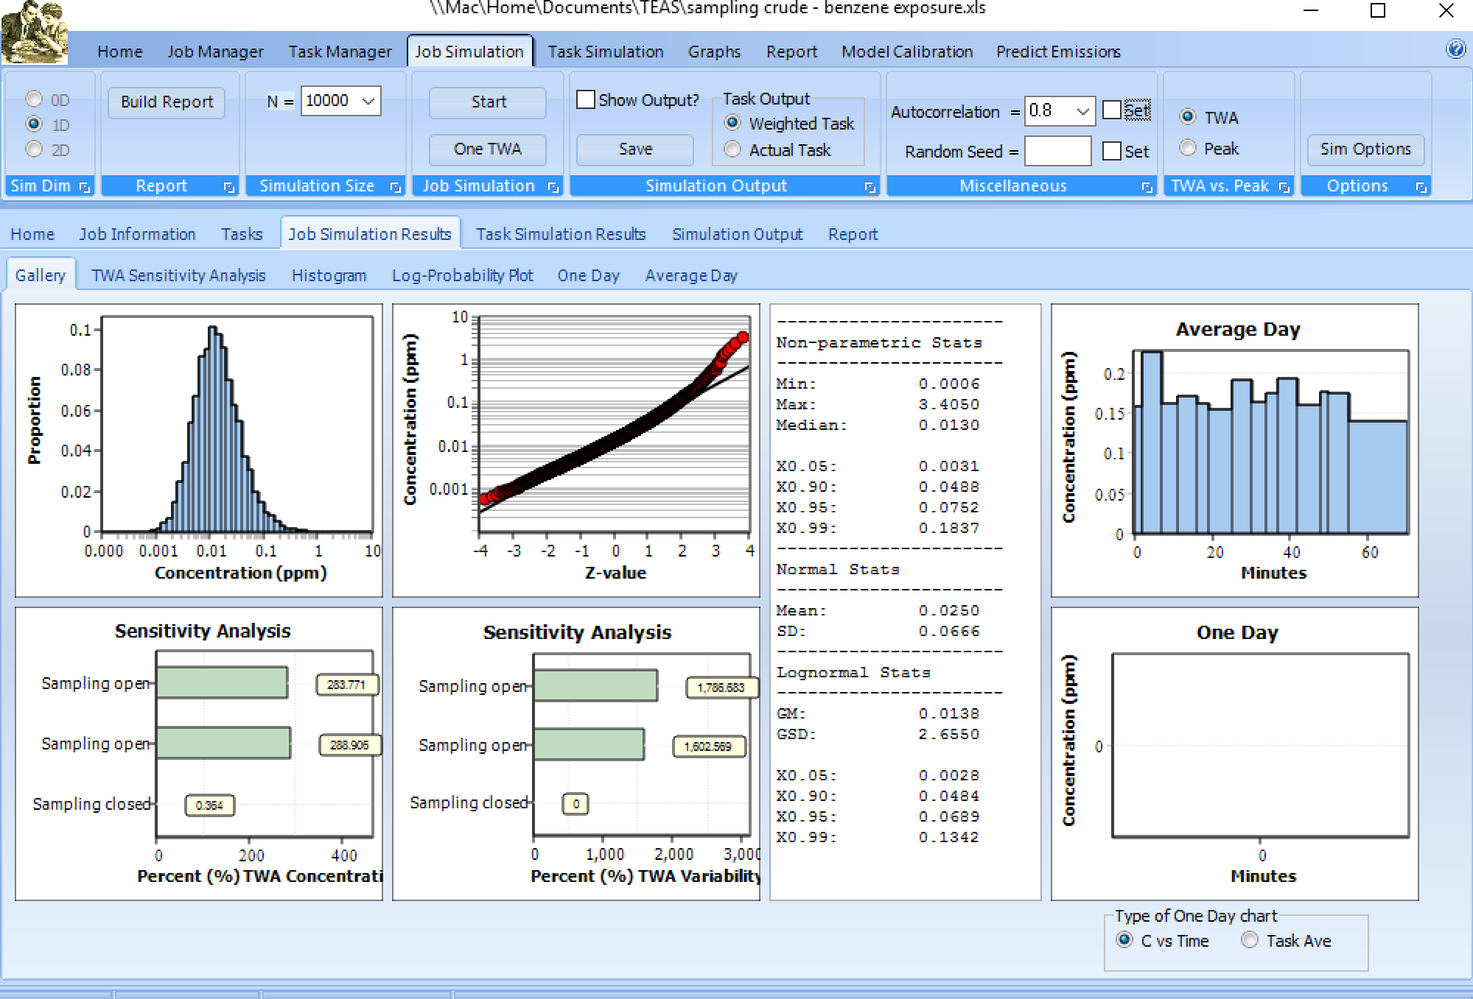
Laboratory worker
Simulert (Monte Carlo) daglig eksponering

Slide 36
Different assessments – different conclusions
Stilling |  | Frekvens | Varighet | Intensitet | M | R-8t | R-15m | B
Mekaniker | Inspeksjons av flowline | Ukentlig | 10 timer | Lav-Høy
 | Inspeksjon av syklon | Årlig | 10 timer | Lav-Høy
 | Inspeksjon av separatorer | 2-3 år (shutdown) | 2-3 timer | Lav-Høy
Prosessteknikker | Skifte filter på plateseparator | Ukentlig | 1 time | Lav
 | Prøvetaking av råolje | Hvert kvartal | 7-8 min | Lav
 | Prøvetaking av produsert vann | Daglig | 15 min | Lav
Laboratorie ing. | Prøvetaking | Daglig | 30 -160 min | Lav

Slide 37
Manage benzene and mercury exposure offshore

Slide 38
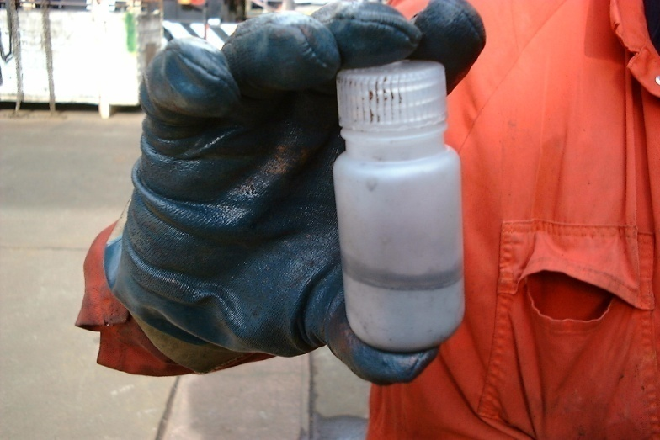

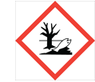


Mercury
In all oil and gas streems
Large variation between wells
Accumulates in all process equipment
Different forms
Hg - Metalic,
Sulfides and oxides
Organic mercury
Notes:
Akutt eksponering:
Forgiftning som ligner metallfeber; frysninger, kvalme, dårlig allmenntilstand, brystsmerter, kortpustethet, hoste, betennelse i tannkjøttet.
Kronisk eksponering:
Permanent skade på hjerne eller nyrene kan være dødelig. Skader på sentralnervesystemet kan påvirke motorikk og kognitive evner (redusert konsentrasjon/hukommelse). Kan opphopes i kroppen.
Fosterskadelig

Slide 39
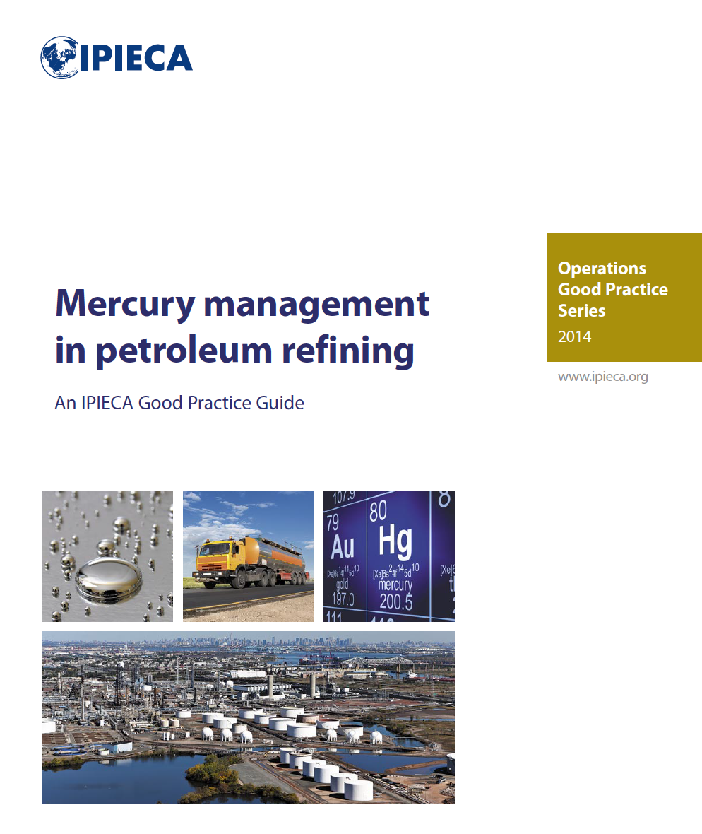
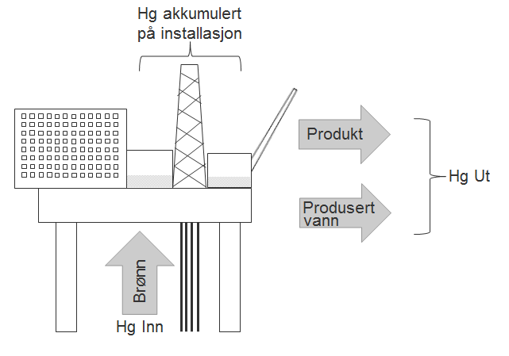
Management of mercury in O&G
10-20 % Loss from well to export stream

Slide 40
OEL Norway
OEL metalic Mercury
8 hour : 0,02 mg/m³ (20 µg/m³)
12 hours: 0,012 mg/m³ (12 µg/m³)
Short term : 0,06 mg/m ³ (60 µg/m³)
OBS!
1 mg = 1 000 µg = 1 000 000 ng

Slide 41
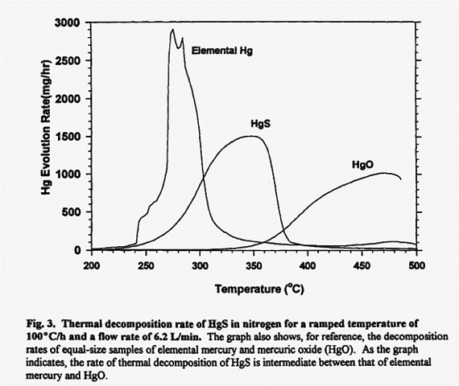

Slide 42
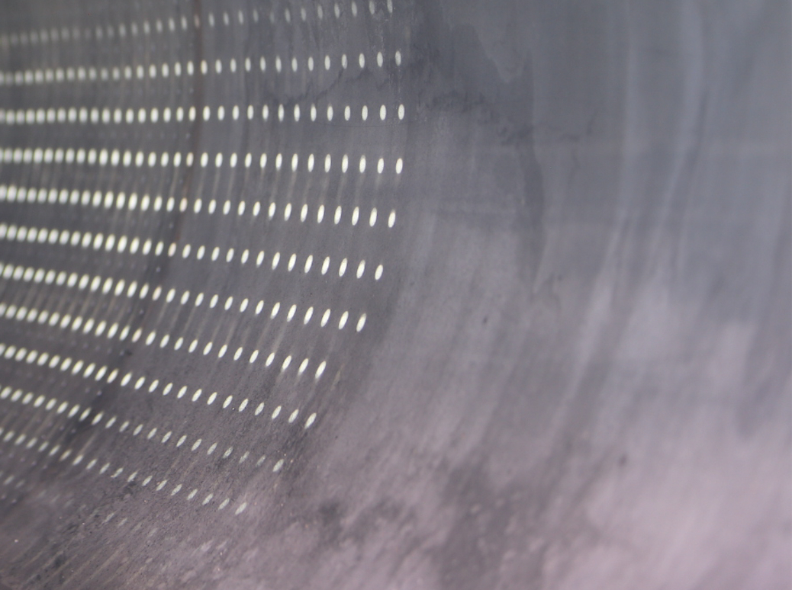
Heating of a ”clean” gas pipe (stainless steel)

Slide 43
SUMMARY
Production of oil and gas = benzene and mercury management
Mercury contamination of process equipment is only a matter of time
Lack of documentation - is not a proof of absence of exposure

Slide 44
NOROG Worker Protection Regime

Slide 45
Decision rules – how to manage the exposure
By area
By task
By exposure level
Exposure limit - knowledge – predictability – training – resources – equipment - PPE

Slide 46
Assigned Protection Factor - respirator
The protection obtained of 95% of the users, 95% of the time.
Type of respirator | APF
Half mask with fixed filter (3M | 4
Half mask w/ combinasjon filter (ABEK1 Hg P3 R) | 10
Full maske w/ combination filter (ABEK1 Hg P3 R) | 20
Fan assisted respirator
Shield + combination filter (ABEK1 Hg P3 R) | 10
Full mask w/ combination filter (ABEK1 Hg P3 R) | 40
Fresh air supplied respirator
Half mask with constant air supply | 50
Full mask with constant air supply | 250
Half mask with demand air supply | 1000
Full mask with demand air supply | 1000
Full mask with demand air supply with over pressure | 2000
Under work

Slide 47
Fit testing of respirator
Qualitative
Quantitative

Slide 48
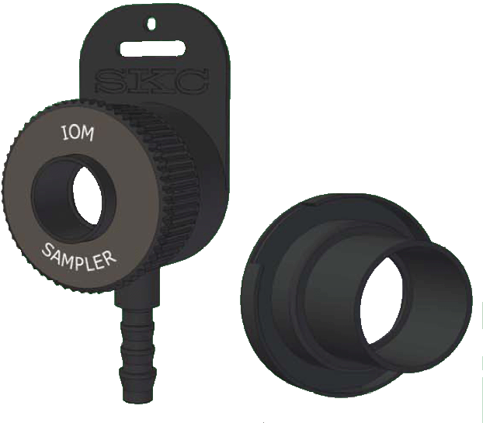
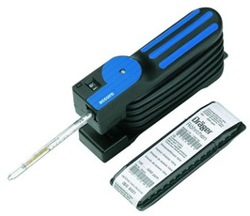
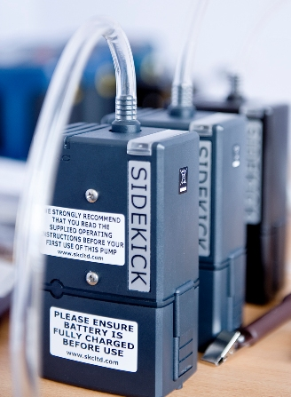
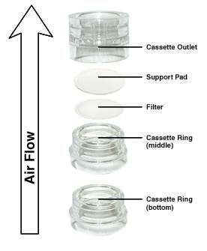
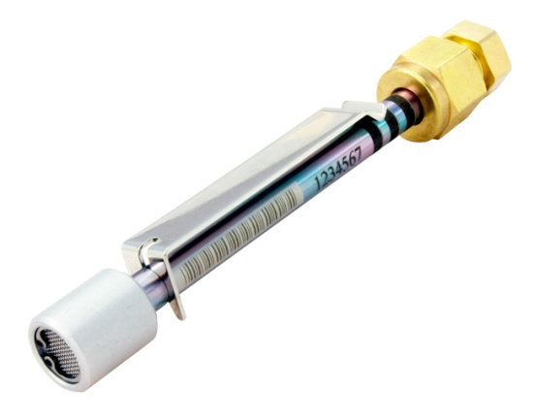
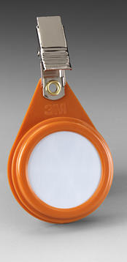
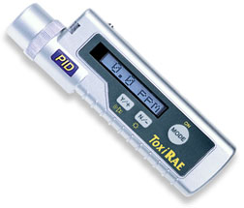
Type measuring equipment

Slide 49
proactima.com
Prepared.

