Slide 1
Yrkeshygieniske-grenseverdier (YGV)
Et hierarki av
vurderingskriterier og verktøy
NYF Årskonferanse Tromsø 2013
Hans Thore Smedbold

Slide 2
Disposisjon
Innledning / bakgrunn
Spørreundersøkelse
Hierarki av vurderingskriterier og verktøy
Erfaringer fra andre konferanser

Slide 3
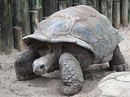
Tradisjonelle YGVer
TLVs, WEELs, MAKs, etc.
Norske tiltaks- og grenseverdier

Slide 4
Spørreundersøkelse
Bedre forstå hvordan vi som gruppe tenker rundt og forstår YGV og hvilke muligheter vi har
Bidra til refleksjon, ideer og diskusjon rundt YGV
Lignende undersøkelser er gjennomført i forbindelse med andre konferanser:
BOHS2012
AIHCE2012
AIOH2012
AIHA Teleweb 2013
SAIHA 2013
NOTE: These surveys represent a biased sample of OH/IH professionals who attend conferences.

Slide 5
http://pollev.com/nyf2013

Slide 7
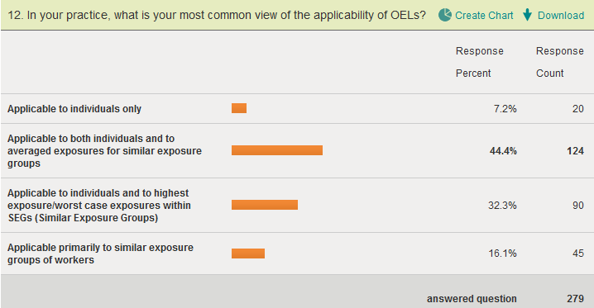
Are OELs set to protect individuals or groups of individuals?
Do IH Professionals really know how to interpret OELs?
Is this clear in the TLV Documentation? (Answer = NO!)
Do you think that a workshop on “Interpreting OELs”
sponsored by ACGIH would be successful? (YES!)

Slide 9
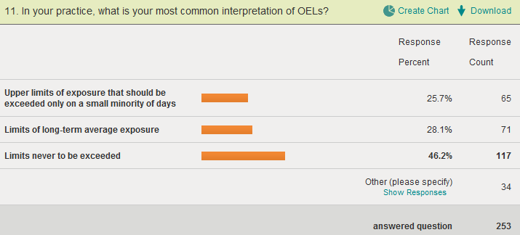
How do we apply different OEL across our profession?
Exposure
Management
(8 hour TWA)
Or
Exposure Matrix
(Epi Study)
Or
Exposure
Management
(Ceiling Limit)
Do you think that a workshop on “Interpreting OELs”
sponsored by ACGIH would be successful? (YES!)

Slide 11
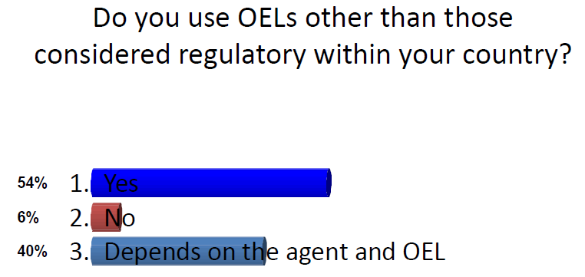
From BOHS 2012 (pre-session)
Only Compliance or Risk Management?

Slide 12
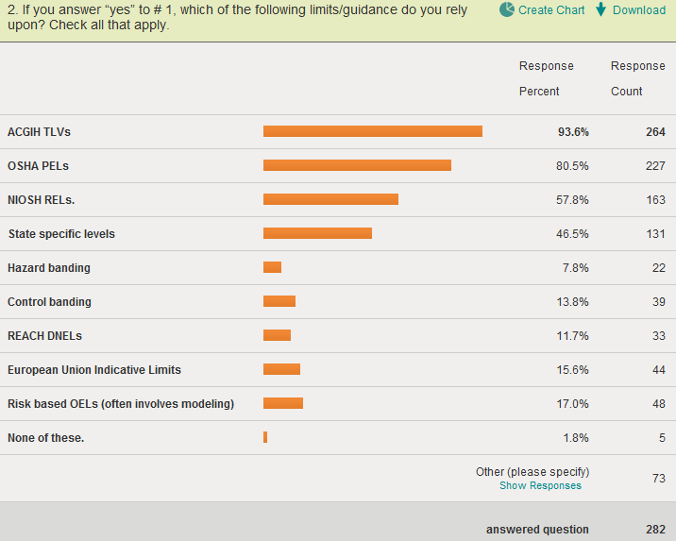
Which OELs do you rely on? (Multiple responses were allowed for this one.)
UK WELs, AIHA WEELs, MAKs & Corporate OELs

Slide 13
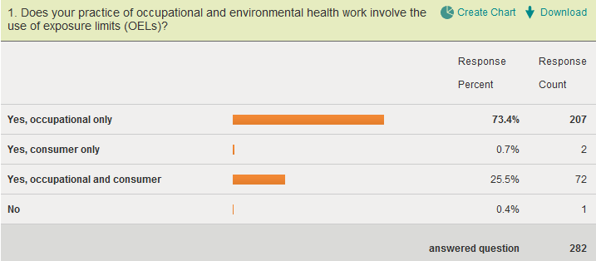
AIHCE2012
Occupational or Consumer or Both?
Is ACGIH missing an opportunity with Consumer Limits?

Slide 15
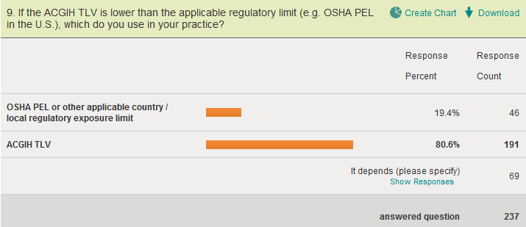
What if the ACGIH TLV is lower than the applicable regulatory OEL?
Are people focused on only Compliance or Risk Management?

Slide 17
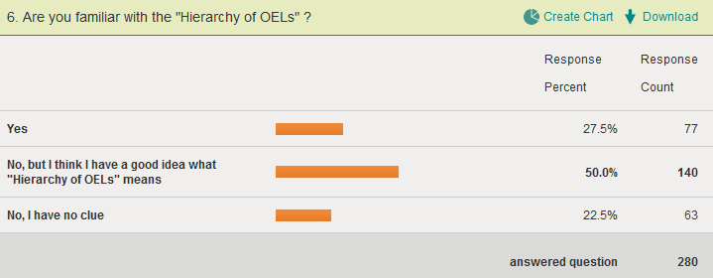
Familiar with “Hierarchy of OELs”?
Pre-session question, large majority “has a clue”

Slide 18
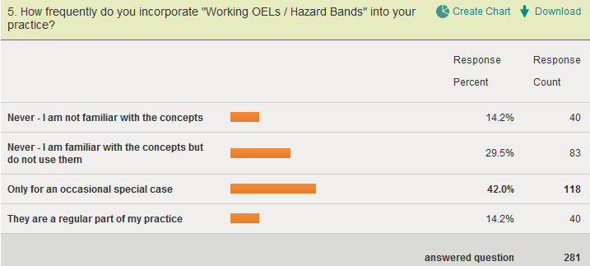
“Working OELs / Hazard Bands”

Slide 20
From BOHS 2012 (post-session)

Slide 22
Beskytte arbeidere og andre best mulig Hierarki av vurderingskriterier og verktøy
TILGANG PÅ TOXIKOLOGISKE DATA
KVALITET / SIKKERHET I EKSPONERINGSVURDER.
GRAD AV TILLIT TIL EN BARRIERE
Hierarki av YGVs / Farerangering |  | Vurderings- hierarki |  | Kontroll- hierarki
Helsebaserte YGV / Nasjonale YGV (tradisjonelle) |  | Validert prøvetaking (1-10% av SEG) |  | Eliminasjon og Substitusjon
Bedrifts / bransje YGVer |  | Direktevisende mfl. (1-10% av SEG) |  | Tekniske barrierer
DNEL / DMEL (REACH) |  | Modellering (10-50% av SEG) |  | Administrative barrierer
Farerangering (Hazard Banding) |  | Kvalitativ Risikovurdering (100% av SEG) |  | Personlige barrierer (PVU)

Slide 23
Strategi basert på iboende fare (fra AIHA, S. Rippel)
Band | A | B | C (default) | D | E
GHS Signal Word | Warning | Warning | Danger | Danger | Danger
OEL (Control) Ranges | > 1,000 µg/m³ | > 100 and < 1,000 µg/m³ | > 10 and < 100 µg/m³ | > 1 and < 10 µg/m³ | < 1 µg/m³
 | > 1000 ppm | > 100 - < 1000 ppm | > 10 - < 100 ppm | > 1 - < 10 ppm | < 1 ppm
Examples of Health Outcomes and Potency Considerations | Minor, reversible health effects occurring at high doses. Skin and eye irritation. | Reversible organ toxicity, skin and eye corrosion (reversible), possible dermal sensitizer at high doses. | Irreversible organ toxicity at high doses, irreversible skin and eye corrosion, dermal sensitizer at moderate doses. | Irreversible organ toxicity at low doses, in vivo genotoxicity, dermal sensitizer at low doses, evidence of mutagenicity, potential developmental and reproductive toxicants. | Human carcinogens at low doses, respiratory sensitization
Examples of GHS Hazard Statements and Hazard Categories | May cause drowsiness or dizziness | Harmful if inhaled (4). Harmful in contact with skin (4). | Toxic if inhaled (3). Toxic in contact with skin (3). Suspected of causing cancer (2). May cause damage to organs (2) | Fatal if inhaled (2). Fatal in contact with skin (1). Causes damage to organs (1). May cause cancer (by route of exposure)—1A or B. Presumed or known human reproductive toxicant (1A or 1B). Causes damage to organs through prolonged or repeated exposure (1) | Fatal if inhaled (1). Fatal in contact with skin (1). May cause cancer (by route of exposure)—1A. May cause allergy or asthma symptoms or breathing difficulties if inhaled (1A resp.). Known human repro toxicant (1A). Causes damage to organs through prolonged or repeated exposure (1)
Notes:
This slide depicts a very high level DRAFT summary of the five OEBs under consideration, the GHS “signal words” that are associated with each band, and anticipated OEL ranges for each band. In the row marked “Examples of health outcomes and potency considerations” you can see how the health outcomes range from minor, reversible health effects at relatively high doses to irreversible effects at moderate doses, to irreversible effects, including death, at low doses. In the row marked “examples of GHS hazard statements and hazard categories, you can see the language that will be included in SDS and the associated hazard categories. We are now in the process of determining how close our OEBs come to NIOSH RELs.

Slide 24
<?xml version="1.0"?><AllQuestions />
<?xml version="1.0"?><Settings><answerBulletFormat>Numeric</answerBulletFormat><answerNowAutoInsert>No</answerNowAutoInsert><answerNowStyle>Explosion</answerNowStyle><answerNowText>Answer Now</answerNowText><chartColors>Use PowerPoint Color Scheme</chartColors><chartType>Horizontal</chartType><correctAnswerIndicator>Checkmark</correctAnswerIndicator><countdownAutoInsert>No</countdownAutoInsert><countdownSeconds>10</countdownSeconds><countdownSound>TicToc.wav</countdownSound><countdownStyle>Box</countdownStyle><gridAutoInsert>No</gridAutoInsert><gridFillStyle>Answered</gridFillStyle><gridFillColor>0,0,0</gridFillColor><gridOpacity>100%</gridOpacity><gridTextStyle>Keypad #</gridTextStyle><inputSource>Response Devices</inputSource><multipleResponseDivisor># of Responses</multipleResponseDivisor><participantsLeaderBoard>5</participantsLeaderBoard><percentageDecimalPlaces>0</percentageDecimalPlaces><responseCounterAutoInsert>No</responseCounterAutoInsert><responseCounterStyle>Oval</responseCounterStyle><responseCounterDisplayValue># of Votes Received</responseCounterDisplayValue><insertObjectUsingColor>Blue</insertObjectUsingColor><showResults>Yes</showResults><teamColors>User Defined</teamColors><teamIdentificationType>None</teamIdentificationType><teamScoringType>Voting pads only</teamScoringType><teamScoringDecimalPlaces>1</teamScoringDecimalPlaces><teamIdentificationItem></teamIdentificationItem><teamsLeaderBoard>5</teamsLeaderBoard><teamName1></teamName1><teamName2></teamName2><teamName3></teamName3><teamName4></teamName4><teamName5></teamName5><teamName6></teamName6><teamName7></teamName7><teamName8></teamName8><teamName9></teamName9><teamName10></teamName10><showControlBar>Slides with Get Feedback Objects</showControlBar><defaultCorrectPointValue>100</defaultCorrectPointValue><defaultIncorrectPointValue>0</defaultIncorrectPointValue><chartColor1>187,224,227</chartColor1><chartColor2>51,51,153</chartColor2><chartColor3>0,153,153</chartColor3><chartColor4>153,204,0</chartColor4><chartColor5>128,128,128</chartColor5><chartColor6>0,0,0</chartColor6><chartColor7>0,102,204</chartColor7><chartColor8>204,204,255</chartColor8><chartColor9>255,0,0</chartColor9><chartColor10>255,255,0</chartColor10><teamColor1>187,224,227</teamColor1><teamColor2>51,51,153</teamColor2><teamColor3>0,153,153</teamColor3><teamColor4>153,204,0</teamColor4><teamColor5>128,128,128</teamColor5><teamColor6>0,0,0</teamColor6><teamColor7>0,102,204</teamColor7><teamColor8>204,204,255</teamColor8><teamColor9>255,0,0</teamColor9><teamColor10>255,255,0</teamColor10><displayAnswerImagesDuringVote>Yes</displayAnswerImagesDuringVote><displayAnswerImagesWithResponses>Yes</displayAnswerImagesWithResponses><displayAnswerTextDuringVote>Yes</displayAnswerTextDuringVote><displayAnswerTextWithResponses>Yes</displayAnswerTextWithResponses><questionSlideID></questionSlideID><controlBarState>Expanded</controlBarState><isGridColorKnownColor>True</isGridColorKnownColor><gridColorName>Yellow</gridColorName><AutoRec></AutoRec><AutoRecTimeIntrvl></AutoRecTimeIntrvl><chartVotesView>Percentage</chartVotesView><chartLabelsColor>0,0,0</chartLabelsColor><isChartLabelColorKnownColor>True</isChartLabelColorKnownColor><chartLabelColorName>Black</chartLabelColorName><chartXAxisLabelType>Full Text</chartXAxisLabelType></Settings>
<?xml version="1.0"?><AllAnswers />
Hierarki av YGVer
Basert på bedre kunnskap om toksikologi og epidemiologi kan vi bevege oss oppover i hierarkiet av YGVer.
Most Extensive Data Requirements
(human epidemiology studies)
> quality, > certainty
Helsebaserte YGVer
Regulatory, Authoritative
Traditional
(TLVs, MAKs, WEELs, PELs, MACs, RELs,…)
Bedrifts eller bransje YGVer
(internal company, trade association, vendor limits)
Moderate Data Requirements
(in vitro and animal studies and anecdotal reports of human health effects)
> quality, > certainty
Preskriptive Prosess Baserte YGVer
(REACH DNELs/DMELs)
Least Data Requirements
(in vitro and animal studies)
Strategier basert på ibonede fare
Pharmaceutical banding
Occupational exposure bands
Hazard Banding + Exposure Banding → Control Banding

Slide 25
Grunnleggende yrkeshygienisk arbeid (YHR –modell)
<?xml version="1.0"?><AllQuestions />
<?xml version="1.0"?><Settings><answerBulletFormat>Numeric</answerBulletFormat><answerNowAutoInsert>No</answerNowAutoInsert><answerNowStyle>Explosion</answerNowStyle><answerNowText>Answer Now</answerNowText><chartColors>Use PowerPoint Color Scheme</chartColors><chartType>Horizontal</chartType><correctAnswerIndicator>Checkmark</correctAnswerIndicator><countdownAutoInsert>No</countdownAutoInsert><countdownSeconds>10</countdownSeconds><countdownSound>TicToc.wav</countdownSound><countdownStyle>Box</countdownStyle><gridAutoInsert>No</gridAutoInsert><gridFillStyle>Answered</gridFillStyle><gridFillColor>0,0,0</gridFillColor><gridOpacity>100%</gridOpacity><gridTextStyle>Keypad #</gridTextStyle><inputSource>Response Devices</inputSource><multipleResponseDivisor># of Responses</multipleResponseDivisor><participantsLeaderBoard>5</participantsLeaderBoard><percentageDecimalPlaces>0</percentageDecimalPlaces><responseCounterAutoInsert>No</responseCounterAutoInsert><responseCounterStyle>Oval</responseCounterStyle><responseCounterDisplayValue># of Votes Received</responseCounterDisplayValue><insertObjectUsingColor>Blue</insertObjectUsingColor><showResults>Yes</showResults><teamColors>User Defined</teamColors><teamIdentificationType>None</teamIdentificationType><teamScoringType>Voting pads only</teamScoringType><teamScoringDecimalPlaces>1</teamScoringDecimalPlaces><teamIdentificationItem></teamIdentificationItem><teamsLeaderBoard>5</teamsLeaderBoard><teamName1></teamName1><teamName2></teamName2><teamName3></teamName3><teamName4></teamName4><teamName5></teamName5><teamName6></teamName6><teamName7></teamName7><teamName8></teamName8><teamName9></teamName9><teamName10></teamName10><showControlBar>Slides with Get Feedback Objects</showControlBar><defaultCorrectPointValue>100</defaultCorrectPointValue><defaultIncorrectPointValue>0</defaultIncorrectPointValue><chartColor1>187,224,227</chartColor1><chartColor2>51,51,153</chartColor2><chartColor3>0,153,153</chartColor3><chartColor4>153,204,0</chartColor4><chartColor5>128,128,128</chartColor5><chartColor6>0,0,0</chartColor6><chartColor7>0,102,204</chartColor7><chartColor8>204,204,255</chartColor8><chartColor9>255,0,0</chartColor9><chartColor10>255,255,0</chartColor10><teamColor1>187,224,227</teamColor1><teamColor2>51,51,153</teamColor2><teamColor3>0,153,153</teamColor3><teamColor4>153,204,0</teamColor4><teamColor5>128,128,128</teamColor5><teamColor6>0,0,0</teamColor6><teamColor7>0,102,204</teamColor7><teamColor8>204,204,255</teamColor8><teamColor9>255,0,0</teamColor9><teamColor10>255,255,0</teamColor10><displayAnswerImagesDuringVote>Yes</displayAnswerImagesDuringVote><displayAnswerImagesWithResponses>Yes</displayAnswerImagesWithResponses><displayAnswerTextDuringVote>Yes</displayAnswerTextDuringVote><displayAnswerTextWithResponses>Yes</displayAnswerTextWithResponses><questionSlideID></questionSlideID><controlBarState>Expanded</controlBarState><isGridColorKnownColor>True</isGridColorKnownColor><gridColorName>Yellow</gridColorName><AutoRec></AutoRec><AutoRecTimeIntrvl></AutoRecTimeIntrvl><chartVotesView>Percentage</chartVotesView><chartLabelsColor>0,0,0</chartLabelsColor><isChartLabelColorKnownColor>True</isChartLabelColorKnownColor><chartLabelColorName>Black</chartLabelColorName><chartXAxisLabelType>Full Text</chartXAxisLabelType></Settings>
<?xml version="1.0"?><AllAnswers />
Vurdering av eksponering
Collect all relevant exposure information and assess exposure risk against
“Hazard Criteria”
Vurdering av iboende fare
Identify and Define
“Hazard Criteria”
Hazard Bands (OEBs)
Exposure Limits (OELs)
Physical, Biological, Chemical
Skin Notations,…
Risikostyring
Define Controls & Exposure Management Programs Utilizing the Hierarchy of Controls
Verifiser (Revurder hvis nødvendig)
Erkjenne
Kontrollere
+
Vurdere
+
Identifisere
Verifisere

Slide 27
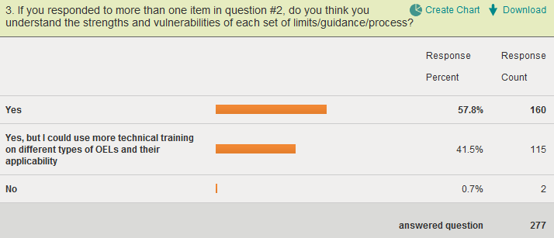
Do you understand the strengths and vulnerabilities of OEL setting processes?
Yes AND Yes, More Training!
Consistent responses for each survey…
Is ACGIH missing a training opportunity?
Partnership with AIHA, AIOH, BOHS?

Slide 28
Hva går vi rundt å kaller oss ? Bruker vi tittelen Yrkeshygieniker ?

Slide 29
Hvordan ser vi på oss selv ?
“I am a special agent authorized to intercede at any point in the scheme of anticipation-recognition-evaluation-control of workplace chemical and physical hazards.”

Slide 30
Takk til
Perry Logan, 3M
Susan Rippel, DOW

Slide 31
proactima.com
Prepared.

Slide 32
Tilleggsmateriale

Slide 33
Utvalgte resultater fra andre konferanser
2012 BOHS (n=82)
2012 AIHCE (n=282)
2012 AIOH (n=165)
AIHA Teleweb (n=60)

Slide 34
<?xml version="1.0"?><AllQuestions />
<?xml version="1.0"?><Settings><answerBulletFormat>Numeric</answerBulletFormat><answerNowAutoInsert>No</answerNowAutoInsert><answerNowStyle>Explosion</answerNowStyle><answerNowText>Answer Now</answerNowText><chartColors>Use PowerPoint Color Scheme</chartColors><chartType>Horizontal</chartType><correctAnswerIndicator>Checkmark</correctAnswerIndicator><countdownAutoInsert>No</countdownAutoInsert><countdownSeconds>10</countdownSeconds><countdownSound>TicToc.wav</countdownSound><countdownStyle>Box</countdownStyle><gridAutoInsert>No</gridAutoInsert><gridFillStyle>Answered</gridFillStyle><gridFillColor>0,0,0</gridFillColor><gridOpacity>100%</gridOpacity><gridTextStyle>Keypad #</gridTextStyle><inputSource>Response Devices</inputSource><multipleResponseDivisor># of Responses</multipleResponseDivisor><participantsLeaderBoard>5</participantsLeaderBoard><percentageDecimalPlaces>0</percentageDecimalPlaces><responseCounterAutoInsert>No</responseCounterAutoInsert><responseCounterStyle>Oval</responseCounterStyle><responseCounterDisplayValue># of Votes Received</responseCounterDisplayValue><insertObjectUsingColor>Blue</insertObjectUsingColor><showResults>Yes</showResults><teamColors>User Defined</teamColors><teamIdentificationType>None</teamIdentificationType><teamScoringType>Voting pads only</teamScoringType><teamScoringDecimalPlaces>1</teamScoringDecimalPlaces><teamIdentificationItem></teamIdentificationItem><teamsLeaderBoard>5</teamsLeaderBoard><teamName1></teamName1><teamName2></teamName2><teamName3></teamName3><teamName4></teamName4><teamName5></teamName5><teamName6></teamName6><teamName7></teamName7><teamName8></teamName8><teamName9></teamName9><teamName10></teamName10><showControlBar>Slides with Get Feedback Objects</showControlBar><defaultCorrectPointValue>100</defaultCorrectPointValue><defaultIncorrectPointValue>0</defaultIncorrectPointValue><chartColor1>187,224,227</chartColor1><chartColor2>51,51,153</chartColor2><chartColor3>0,153,153</chartColor3><chartColor4>153,204,0</chartColor4><chartColor5>128,128,128</chartColor5><chartColor6>0,0,0</chartColor6><chartColor7>0,102,204</chartColor7><chartColor8>204,204,255</chartColor8><chartColor9>255,0,0</chartColor9><chartColor10>255,255,0</chartColor10><teamColor1>187,224,227</teamColor1><teamColor2>51,51,153</teamColor2><teamColor3>0,153,153</teamColor3><teamColor4>153,204,0</teamColor4><teamColor5>128,128,128</teamColor5><teamColor6>0,0,0</teamColor6><teamColor7>0,102,204</teamColor7><teamColor8>204,204,255</teamColor8><teamColor9>255,0,0</teamColor9><teamColor10>255,255,0</teamColor10><displayAnswerImagesDuringVote>Yes</displayAnswerImagesDuringVote><displayAnswerImagesWithResponses>Yes</displayAnswerImagesWithResponses><displayAnswerTextDuringVote>Yes</displayAnswerTextDuringVote><displayAnswerTextWithResponses>Yes</displayAnswerTextWithResponses><questionSlideID></questionSlideID><controlBarState>Expanded</controlBarState><isGridColorKnownColor>True</isGridColorKnownColor><gridColorName>Yellow</gridColorName><AutoRec></AutoRec><AutoRecTimeIntrvl></AutoRecTimeIntrvl><chartVotesView>Percentage</chartVotesView><chartLabelsColor>0,0,0</chartLabelsColor><isChartLabelColorKnownColor>True</isChartLabelColorKnownColor><chartLabelColorName>Black</chartLabelColorName><chartXAxisLabelType>Full Text</chartXAxisLabelType></Settings>
<?xml version="1.0"?><AllAnswers />
Hierarchy of OELs
As more toxicological and
epidemiological data becomes available, we move up the hierarchy of OELs.
Most Extensive Data Requirements
(human epidemiology studies)
> quality, > certainty
Health Based OELs
Regulatory, Authoritative
Traditional
(TLVs, MAKs, WEELs, PELs, MACs, RELs,…)
Working Provisional OELs
(internal company, trade association, vendor limits)
Moderate Data Requirements
(in vitro and animal studies and anecdotal reports of human health effects)
> quality, > certainty
Prescriptive Process Based OELs
(REACH DNELs/DMELs)
Least Data Requirements
(in vitro and animal studies)
Hazard Banding Strategies
Pharmaceutical banding
Occupational exposure bands
Hazard Banding + Exposure Banding → Control Banding

Slide 35
Fundamental Elements of Industrial Hygiene (ERAM Model)
<?xml version="1.0"?><AllQuestions />
<?xml version="1.0"?><Settings><answerBulletFormat>Numeric</answerBulletFormat><answerNowAutoInsert>No</answerNowAutoInsert><answerNowStyle>Explosion</answerNowStyle><answerNowText>Answer Now</answerNowText><chartColors>Use PowerPoint Color Scheme</chartColors><chartType>Horizontal</chartType><correctAnswerIndicator>Checkmark</correctAnswerIndicator><countdownAutoInsert>No</countdownAutoInsert><countdownSeconds>10</countdownSeconds><countdownSound>TicToc.wav</countdownSound><countdownStyle>Box</countdownStyle><gridAutoInsert>No</gridAutoInsert><gridFillStyle>Answered</gridFillStyle><gridFillColor>0,0,0</gridFillColor><gridOpacity>100%</gridOpacity><gridTextStyle>Keypad #</gridTextStyle><inputSource>Response Devices</inputSource><multipleResponseDivisor># of Responses</multipleResponseDivisor><participantsLeaderBoard>5</participantsLeaderBoard><percentageDecimalPlaces>0</percentageDecimalPlaces><responseCounterAutoInsert>No</responseCounterAutoInsert><responseCounterStyle>Oval</responseCounterStyle><responseCounterDisplayValue># of Votes Received</responseCounterDisplayValue><insertObjectUsingColor>Blue</insertObjectUsingColor><showResults>Yes</showResults><teamColors>User Defined</teamColors><teamIdentificationType>None</teamIdentificationType><teamScoringType>Voting pads only</teamScoringType><teamScoringDecimalPlaces>1</teamScoringDecimalPlaces><teamIdentificationItem></teamIdentificationItem><teamsLeaderBoard>5</teamsLeaderBoard><teamName1></teamName1><teamName2></teamName2><teamName3></teamName3><teamName4></teamName4><teamName5></teamName5><teamName6></teamName6><teamName7></teamName7><teamName8></teamName8><teamName9></teamName9><teamName10></teamName10><showControlBar>Slides with Get Feedback Objects</showControlBar><defaultCorrectPointValue>100</defaultCorrectPointValue><defaultIncorrectPointValue>0</defaultIncorrectPointValue><chartColor1>187,224,227</chartColor1><chartColor2>51,51,153</chartColor2><chartColor3>0,153,153</chartColor3><chartColor4>153,204,0</chartColor4><chartColor5>128,128,128</chartColor5><chartColor6>0,0,0</chartColor6><chartColor7>0,102,204</chartColor7><chartColor8>204,204,255</chartColor8><chartColor9>255,0,0</chartColor9><chartColor10>255,255,0</chartColor10><teamColor1>187,224,227</teamColor1><teamColor2>51,51,153</teamColor2><teamColor3>0,153,153</teamColor3><teamColor4>153,204,0</teamColor4><teamColor5>128,128,128</teamColor5><teamColor6>0,0,0</teamColor6><teamColor7>0,102,204</teamColor7><teamColor8>204,204,255</teamColor8><teamColor9>255,0,0</teamColor9><teamColor10>255,255,0</teamColor10><displayAnswerImagesDuringVote>Yes</displayAnswerImagesDuringVote><displayAnswerImagesWithResponses>Yes</displayAnswerImagesWithResponses><displayAnswerTextDuringVote>Yes</displayAnswerTextDuringVote><displayAnswerTextWithResponses>Yes</displayAnswerTextWithResponses><questionSlideID></questionSlideID><controlBarState>Expanded</controlBarState><isGridColorKnownColor>True</isGridColorKnownColor><gridColorName>Yellow</gridColorName><AutoRec></AutoRec><AutoRecTimeIntrvl></AutoRecTimeIntrvl><chartVotesView>Percentage</chartVotesView><chartLabelsColor>0,0,0</chartLabelsColor><isChartLabelColorKnownColor>True</isChartLabelColorKnownColor><chartLabelColorName>Black</chartLabelColorName><chartXAxisLabelType>Full Text</chartXAxisLabelType></Settings>
<?xml version="1.0"?><AllAnswers />
Exposure Risk Assessment
Collect all relevant exposure information and assess exposure risk against
“Hazard Criteria”
Hazard Assessment
Identify and Define
“Hazard Criteria”
Hazard Bands (OEBs)
Exposure Limits (OELs)
Physical, Biological, Chemical
Skin Notations,…
Exposure Management
Define Controls & Exposure Management Programs Utilizing the Hierarchy of Controls
Confirm (Re-Evaluate as Needed)
Anticipation
Control
+
Evaluation
+
Recognition
Confirm

